Slide 1
Datenorganisation
Spring School 2022
Julius

Slide 2




“Stundenplan”

Slide 3
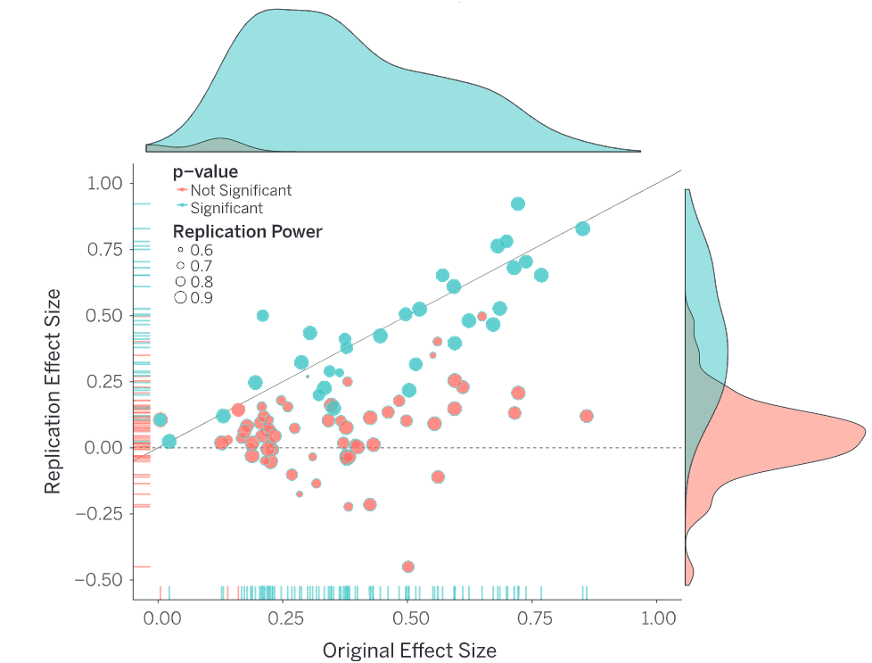
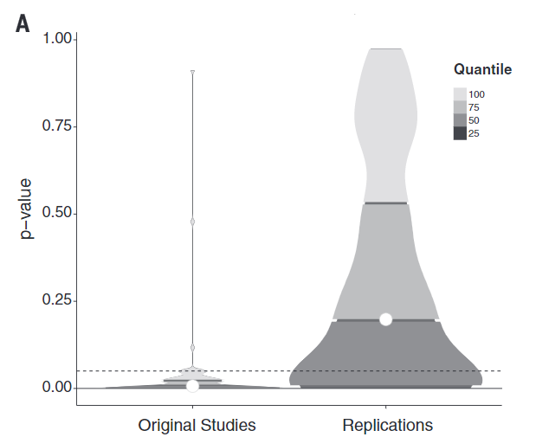
ReplikationsKRISE in Psychology
Replications of 100 experimental and correlational studies
Evaluate reproducibility using significance, p-values and effect sizes
36% of replications had significant results
47% of original effect sizes were in the 95% CI of the replication effect size
Open Science Collaboration, Science, 2015; Ioannidis , PLOS Medicine, 2005
Notes:
Direct replicationmainly provides evidence for the reliability of aresult

Slide 4
When will‘open science’become simply‘science’
Open access
papers are available for anyone to read without having to pay
Open methodology
allow other researchers to repeat the work and apply it elsewhere
Open source
open and free access to the blueprint of a product (software-source code)
Open peer review
making peer review a collaborative process between authors and reviewer
Open education
open and free availability of educational resource
Open data
releasing both raw and processed data from your experiments, enabling others to analyse it without restrictions
Watson ea., Genome Biology, 2015

Slide 5


Slide 6
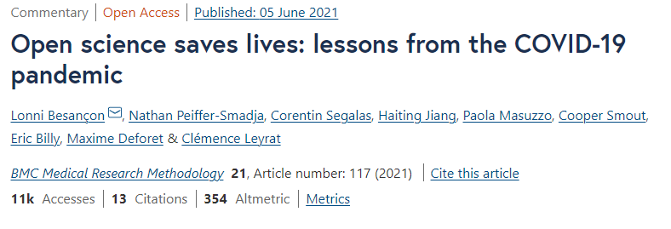
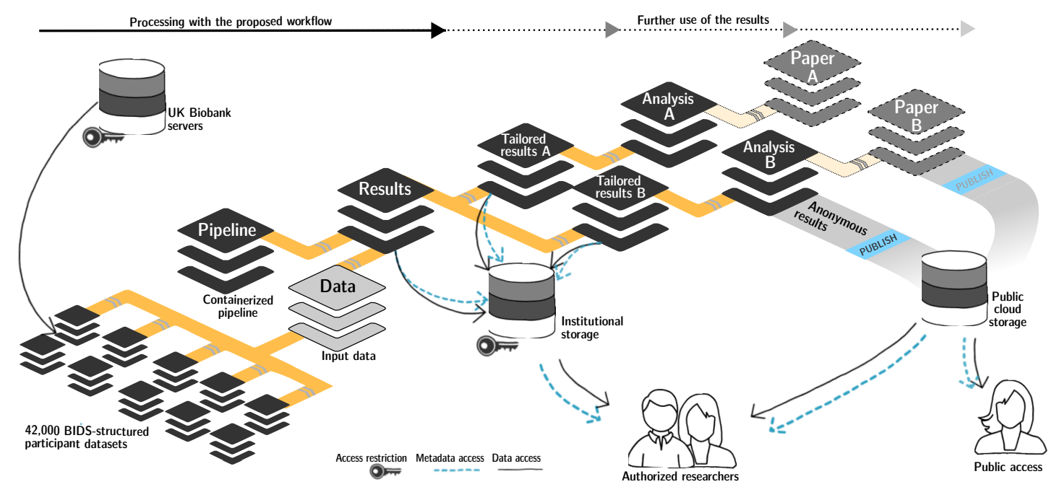
Warum?
Wagner ea., bioRxiv, 2021

Slide 7
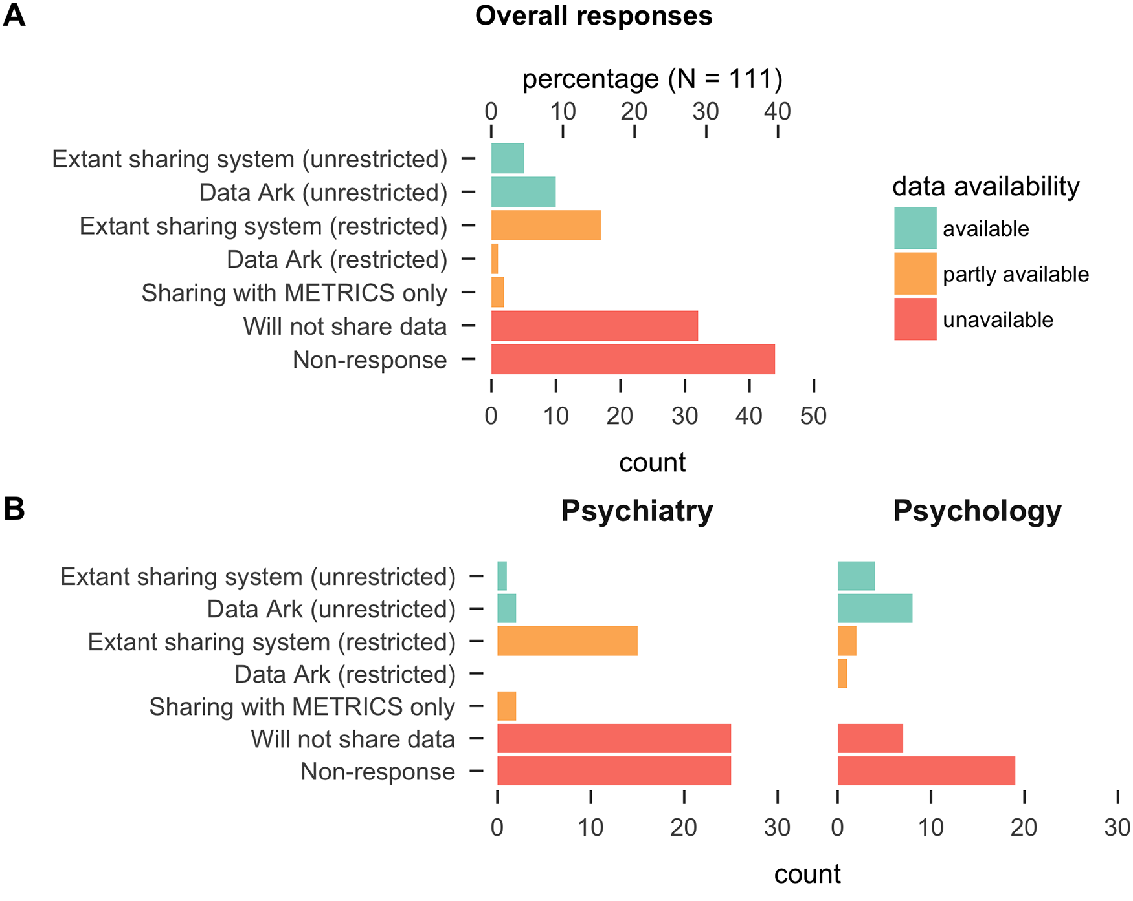
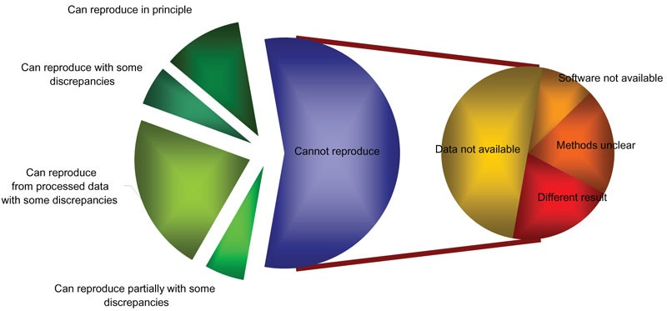
Reproduzierbarkeit von Daten
Ioannidis, Nature Genetics, 2009; Hardwicke ea., PLoS ONE, 2018

Slide 8

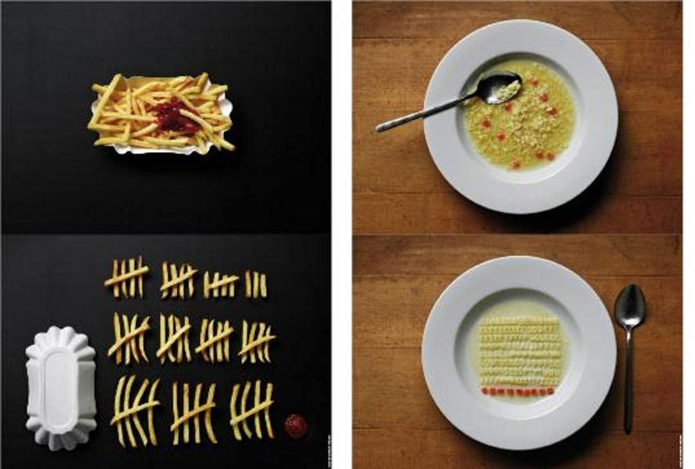
Ein Beispiel
Example1/
├─README.tsv
├─dataset_description.json
├─participants.json
├─participants.tsv
└─ sub-001
├─eeg/
└─motion/
├─sub-01_ses-01_task-BalanceTandemStand_motion.tsv
├─sub-01_ses-01_task-BalanceTandemStand_motion.json
└─sub-01_ses-01_task-BalanceTandemStand_channels.tsv
├─ sub-002
└─ sub-003
https://bids-specification.readthedocs.io/en/stable/; https://github.com/bids-standard/bids-examples

Slide 9
BIDS schema: example
participants.json
"age": {
"Description": "age of the participant", "Units": "years" },
"sex": {
"Description": "sex as reported by the participant”, "Levels": {
"M": "male",
"F": “female" }
Example1/
├─README.tsv
├─dataset_description.json
├─participants.json
├─participants.tsv
└─ sub-001
├─ ses-01
├─ ses-02
├─ sub-002
└─ sub-003
participants.tsv
participant_id age sex
sub-001 34 M
sub-002 12 F
sub-003 33 F

Slide 10
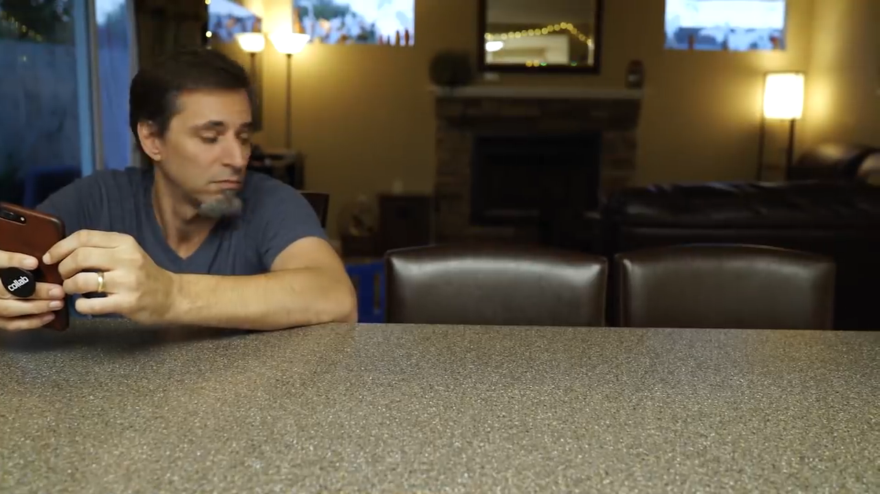

Slide 11
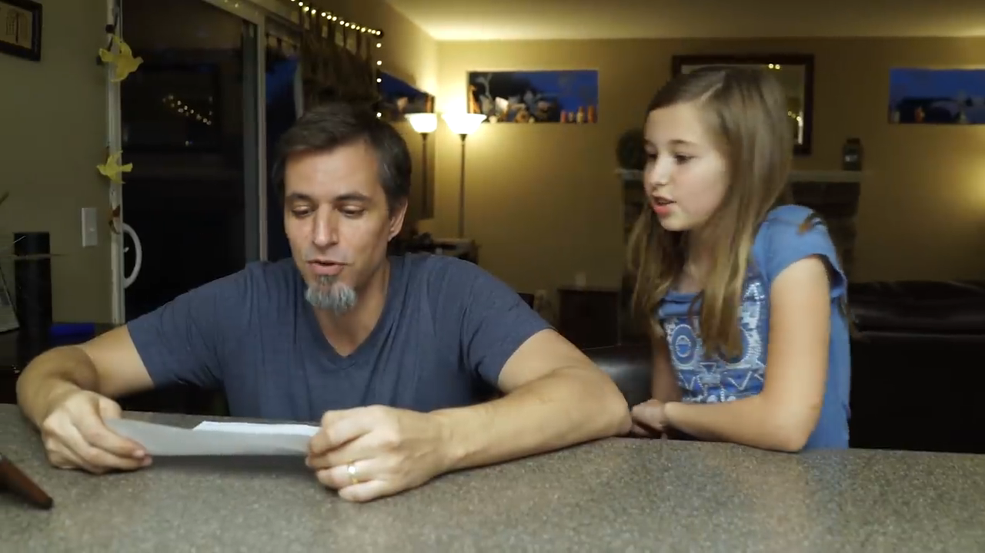

Slide 12
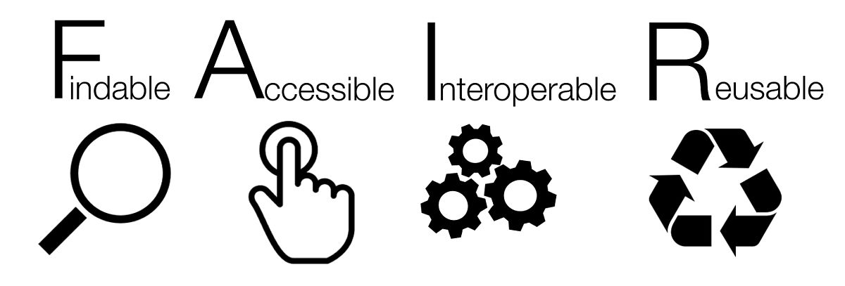
FAIR principles
Findable
Accessible
Interoperable
Reusable
Wilkinson ea., Scientific Data, 2016

Slide 13
Gruppenarbeit (ca. 60 min)
Erhöhen des Truck Faktores eures Experiments
“The number of people on your team who have to be hit with a truck before the project is in serious trouble”
Projektorder von gestern als Grundlage
Aufgaben:
1. Ordner/Daten Struktur entwickeln wo was gespeichert ist
Ordner: skripte, daten, “codebook”
https://psych-transparency-guide.uni-koeln.de/folder-structure.html
2. Auswertungsskript anpassen (single subject & group)

Slide 14
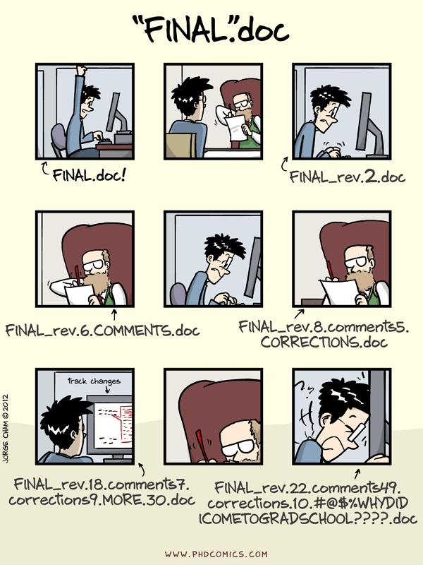
Versionskontrolle

Slide 15
Bibliography
Aarts, A. A., Anderson, J. E., Anderson, C. J., Attridge, P. R., Attwood, A., Axt, J., Babel, M., Bahník, Š., Baranski, E., Barnett-Cowan, M., Bartmess, E., Beer, J., Bell, R., Bentley, H., Beyan, L., Binion, G., Borsboom, D., Bosch, A., Bosco, F. A., … Zuni, K. (2015). Estimating the reproducibility of psychological science. Science, 349(6251). https://doi.org/10.1126/SCIENCE.AAC4716/SUPPL_FILE/AARTS-SM.PDF
Hardwicke, T. E., & Ioannidis, J. P. A. (2018). Populating the Data Ark: An attempt to retrieve, preserve, and liberate data from the most highly-cited psychology and psychiatry articles. PLOS ONE, 13(8), e0201856. https://doi.org/10.1371/JOURNAL.PONE.0201856
Ioannidis, J. P. A. (2005). Why Most Published Research Findings Are False. PLOS Medicine, 2(8), e124. https://doi.org/10.1371/JOURNAL.PMED.0020124
Ioannidis, J. P. A., Allison, D. B., Ball, C. A., Coulibaly, I., Cui, X., Culhane, A. C., Falchi, M., Furlanello, C., Game, L., Jurman, G., Mangion, J., Mehta, T., Nitzberg, M., Page, G. P., Petretto, E., & van Noort, V. (2009). Repeatability of published microarray gene expression analyses. Nature Genetics 2009 41:2, 41(2), 149–155. https://doi.org/10.1038/ng.295
Wagner, A. S., Waite, L. K., Wierzba, M., Hoostaedter, F., Waite, A. Q., Poldrack, B., Eickhoo, S. B., & Hanke, M. (2021). FAIRly big: A framework for computationally reproducible processing of large-scale data. https://doi.org/10.1101/2021.10.12.464122
Watson, M. (2015). When will “open science” become simply “science”? Genome Biology, 16(1), 1–3. https://doi.org/10.1186/S13059-015-0669-2/METRICS
Wilkinson, M. D., Dumontier, M., Aalbersberg, Ij. J., Appleton, G., Axton, M., Baak, A., Blomberg, N., Boiten, J. W., da Silva Santos, L. B., Bourne, P. E., Bouwman, J., Brookes, A. J., Clark, T., Crosas, M., Dillo, I., Dumon, O., Edmunds, S., Evelo, C. T., Finkers, R., … Mons, B. (2016). The FAIR Guiding Principles for scientific data management and stewardship. Scientific Data 2016 3:1, 3(1), 1–9. https://doi.org/10.1038/sdata.2016.18

